Slide 1
The Team Huddle: Calling the Audible presentation will start shortly.

Slide 2
Agenda
Progress monitoring process
Student progress monitoring example
CISDM demonstration & considerations
Review of resources

Slide 3
Learning Objectives
At the conclusion of the webinar, participants will be able to:
apply the monitoring and adjusting process at their school site.
compare expected and actual progress.
document monitoring and adjusting process in CISDM.

Slide 5
Progress monitoring process
Establish what data you need and determine how to get it.
Collect and organize school/student data
Review data and school/student goal(s)
Determine whether progress has been made
If not, why? Was it because supports weren’t provided as planned? Supports didn’t meet the student’s needs?
Adjust the school/student plan, if necessary
Document in CISDM

Slide 6
Monitoring and Adjusting Flowchart
Is the school/student progressing towards its/his/her goal(s)?
Yes. Great! Check to make sure nothing has happened that isn't captured in the data.
No. Why (dig deep)? Is it something new or is it possible the current supports did not meet the student's needs?
Supports did not meets school’s/student's needs.
A new need arose.
Ensure supports are aligned to identified needs. Adjust intensity, if necessary.
Link additional supports to address the new need and document changes to School/Student Support Plan.
Notes:
Fidelity, partners actually providing services

Slide 7
Monitoring and Adjusting: Student
What is the student’s goal for the entire year?
Expected Progress in 1st grading period
Actual Progress in 1st grading period
On-track/progressing or Off-track/declined/no progress?
Off-track: Determine the root cause and adjust accordingly.
On-track: If nothing else has changed, continue as planned!

Slide 8
Monitoring and Adjusting: Student
What is the student’s goal for the entire year?
95% Attendance Rate (9 absences)
Expected Progress in 1st grading period
95% attendance rate or higher
(no more than 3 absences)
Actual Progress in 1st grading period
85% attendance rate
(6 or 7 absences)
On-track or Off-track?
Off-track: Determine the root cause and adjust accordingly.
On-track: If nothing else has changed, continue as planned!
Because the student is off-track in terms of achieving his goal, we have a discussion with the student and find out his family was evicted and had to move in with a family member.

Slide 9
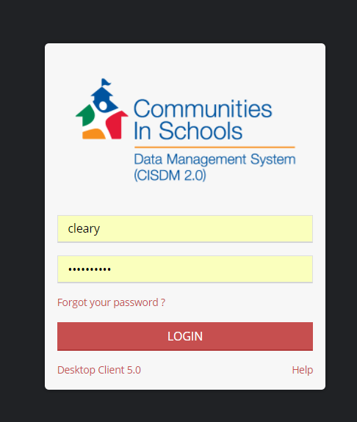
CISDM Exercise

Slide 10
Considerations
Problem | Solution
No line with progress monitoring appears for the 17-18 school needs assessment | Start the school needs assessment by going into Edit School Needs Assessment and clicking New School Needs Assessment Part 1
No goal/metric appears under progress monitoring at the school-level | Go into Edit School Needs Assessment and click the gear icon, then click Edit Goals/Metrics and ensure a goal with metric is selected.
No goal/metric appears under progress monitoring at the student-level | From the student dashboard, click Goal Setting & Support Planning, click the gear icon, and then click Edit ABC Goals/Target. Select a goal/metric.

Slide 11
www.cisnc.org → affiliate login →CISNC1989

